Slide 1


Low Power, High-performance sense amplifier using FinFET technology.

Slide 2
TEAM MEMBERS
2310040095 – SAYOOJ S
2310040004 – MD SAMEER
2310040079 – VENKAT PRASAD

Slide 3
PROBLEM STATEMENT:
Low Power, High-performance sense amplifier using FinFET technology.

Slide 4
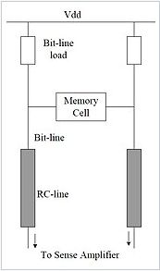
Sense Amplifier:
A circuit used in memory cells to detect and amplify small voltage differences on bit lines for reliable data reading.
FinFET:
A multi-gate transistor with a 3D fin-like structure that improves electrostatic control, reducing leakage and enhancing performance in modern semiconductor devices

Slide 5
OBJECTIVE:
Develop a FinFET-based sense amplifier by optimizing architecture, and latch design to achieve superior speed, lower power.

Slide 6
PROJECT OUTCOME:
Enhanced Data Sensing:
Power Efficiency:
Performance Improvement:

